Slide 1
Social Perception and Diversity

Slide 2
Social Perception
Much like personality traits, our perceptions can also create individual differences that impact our behavior in various situations
Social perception is the process of interpreting information about another person; perception adds meaning to information gathered by the senses
LECTURE 4: Social Perception ∙ Attribution ∙ Diversity Management
Notes:
We deduce characteristics about people using information (i.e., their behavior or appearance). The problem is, we don’t have infinite time nor information with which to form perfect perceptions of other people’s characteristics. Because we have other goals and internal processes pushing us forward in life, our brains try to balance ACCURACY with EFFICIENCY. It makes itself more efficient by using CURRENT information about people to understand new people it encounters, but we often don’t take the time to hone those perceptions and make them more ACCURATE.

Slide 3
Social Perception
Three things influence our perceptions:
Perceiver (our) characteristics: Familiarity, attitudes, moods, self-concept, cognitive structure
Target (their) characteristics: Appearance, verbal communication, nonverbal cues, intentions
Situational characteristics: Context, situation strength
LECTURE 4: Social Perception ∙ Attribution ∙ Diversity Management
Notes:
Our brains are trying to balance efficiency with accuracy. What kind of person information do we have the most of? INFORMATION ABOUT OURSELVES. Our perception of reality is the starting point for understanding who other people are and why they do what they do. Jones’ theory of attribution suggests that we use our own sense of self as the initial baseline for understanding others, then we make corrections based on (1) the way they look or (2) the things they do in certain situations. WE USE THAT INFORMATION TO FIGURE OUT WHAT KIND OF A PERSON THEY ARE

Slide 4
Stereotypes and Exemplars
Researchers mailed 5000 résumés to potential employers, using “white-sounding” and “black-sounding” names (Bertrand & Mullainathan, 2004)
Callback rates on identical résumés were substantially higher for white-sounding names than for black-sounding names
LECTURE 4: Social Perception ∙ Attribution ∙ Diversity Management

Slide 5
Stereotypes and Exemplars
Racial stereotyping is still prevalent in the workforce. A study of 340 jobs found that: (Pager, Bonikowski, & Western, 2009)
White applicants (to low-wage NYC jobs) were twice as likely to receive a job offer or callback than equally-qualified black counterparts
White individuals just released from prison (on cocaine charges) were just as likely to receive a job offer as blacks or Latinos with no criminal background
LECTURE 4: Social Perception ∙ Attribution ∙ Diversity Management

Slide 6
Stereotypes and Exemplars
Physical appearance is linked with favorable hiring, ranking, promotion, and performance evaluations. We hold (unwarranted) higher expectations for people who look attractive
The effect is stronger for evaluations of social competence, than for adjustment or intellectual ability (near zero for integrity or other-concern)
LECTURE 4: Social Perception ∙ Attribution ∙ Diversity Management

Slide 7
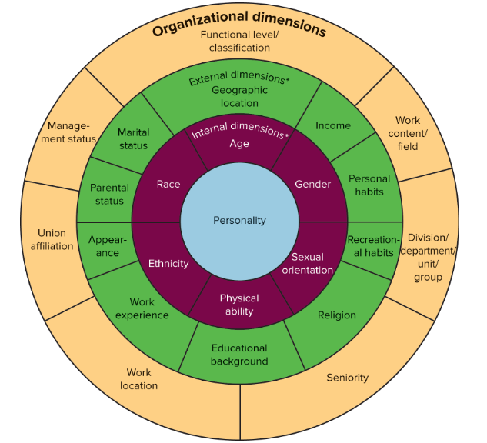
Stereotypes and Exemplars
LECTURE 4: Social Perception ∙ Attribution ∙ Diversity Management
Notes:
There are many characteristics around which stereotypes can form

Slide 8
Social Discrimination
Categorizing people by different characteristics isn’t inherently bad, it’s an important way to understand the complexities of life
Social perceptions turn toxic when we assign negative value to people who fit stereotypes or exemplars (rather than forming more accurate perceptions based on their actual behavioral patterns), and treat them differently because of these emotional assessments; this is discrimination
LECTURE 4: Social Perception ∙ Attribution ∙ Diversity Management

Slide 9
Social Discrimination
Both sexual harassment and perceiving oneself to be racially discriminated against are linked with decreased satisfaction and commitment, as well as physical & mental health issues; racial discrimination is linked with lower OCB
(Willness, Steel, & Lee, 2007: Meta-analysis of 70,000 total subjects; Triana, Jayasinghe, & Pieper, 2015: meta-analysis with nearly 100,000 total subjects for some conditions)
Harassment in general is also linked with decreased job performance and increased negative behavior by victims
(Bowling & Beehr, 2006: Meta-analysis of 20,000 total subjects)
Older workers equally qualified as younger workers receive lower ratings in interviews and on performance appraisals
(Posthuma & Campion, 2009: Large review of literature)
LECTURE 4: Social Perception ∙ Attribution ∙ Diversity Management
Notes:
Discrimination usually arises because people are perceived to be different than oneself.

Slide 10
Social Discrimination
LECTURE 4: Social Perception ∙ Attribution ∙ Diversity Management

Slide 11
Social Perception: Barriers
Major barriers to perceptual accuracy, which can often time cause use to be discriminatory:
Selective perception: Ignore information that doesn’t support one’s desired viewpoint
Chronic stereotyping: Never refining one’s perception of others beyond initial stereotypes
First-impression error: Infer multiple characteristics about a person from only a brief encounter
LECTURE 4: Social Perception ∙ Attribution ∙ Diversity Management

Slide 12
Social Perception: Barriers
Impression management is behaving in ways to generate a positive image in the eyes of others, there are two general types:
Other-enhancing: Ingratiation (flattery, favor doing, compliments, conformity)
Self-enhancing: Exemplify desired values/ideals, Self-promote accomplishment/qualities
Not only is it difficult to discern people’s internal characteristics, but they may be actively masking them, further skewing social perception
LECTURE 4: Social Perception ∙ Attribution ∙ Diversity Management

Slide 13
Attribution
When observing ours or others behavior, we “attribute” certain causes to that behavior; these attributions help us discern the drivers of their actions and deduce underlying characteristics
We attribute behavior to either:
Internal causes within a person’s control (e.g., personality, ability, values, effort, etc.)
External causes outside of a person’s control (e.g., task difficulty, luck, situation, etc.)
LECTURE 4: Social Perception ∙ Attribution ∙ Diversity Management

Slide 14
Attribution
LECTURE 4: Social Perception ∙ Attribution ∙ Diversity Management

Slide 15
Attribution: Biases
Fundamental attribution error (a.k.a., the correspondence bias): Tendency to make internal attributions when observing others’ behavior; this is one of the most robust and consistent effects in social psychology
Self-serving bias: Tendency to make internal attributions for our successes, yet external attributions for our failures
LECTURE 4: Social Perception ∙ Attribution ∙ Diversity Management

Slide 16
Attribution: Biases
People tend to make a correspondence bias even in the presence of strong situations because:
They unintentionally ignore situational information
They intentionally ignore situational information because the internal attribution is valuable
They use situational information to enhance the internal attribution
Personality can also affect one’s attributional tendencies for others (i.e., locus of control)
LECTURE 4: Social Perception ∙ Attribution ∙ Diversity Management

Slide 17
What does this all mean?
People are complex but imperfect evaluators of others’ characteristics, and often rely on inaccurate information to understand them; we perceive other people without realizing it
Managers and organizations can enact policies, procedures, and practices that reduce inaccuracies in social perception; although such Diversity Management can be challenging
LECTURE 4: Social Perception ∙ Attribution ∙ Diversity Management

Slide 18
Diversity Management
Diversity Management involves changing the culture, assumptions, and structure of an organization to thrive in the presence of diversity
Affirmative Action is any policy designed to right the wrongs of the past, it is inherently past-oriented, not future-oriented; it is often rejected by those who need it the most (i.e., people with racist attitudes), and can cause diverse individuals to feel stigmatized
LECTURE 4: Social Perception ∙ Attribution ∙ Diversity Management

Slide 19
Diversity Management
A study of 1,731 public employees (50% police, 15% firefighters, 35% office workers) found that people who perceived their workplace to support equal treatment and equal access for employees regardless of their diverse characteristics, were less likely to turnover
(Chrobot-Mason & Aramovich, 2013)
They were less likely to turnover because they identified with their organization more, felt a sense of empowerment, and felt free to define themselves in whatever manner they chose
LECTURE 4: Social Perception ∙ Attribution ∙ Diversity Management

Slide 20
Diversity Management
A study of 26 different locations of a restaurant chain found that intention to quit is greater when there is greater gender diversity, however, this effect is neutralized when the organizational climate supports diversity
(Gonzalez & Denisi, 2009)
Racial diversity also positively affected restaurant productivity and return on income in a supportive diversity climate, but gender diversity had a U-shaped relationship with firm performance
LECTURE 4: Social Perception ∙ Attribution ∙ Diversity Management

Slide 21
Diversity Management
A recent study of 132 successful companies revealed that those with active Diversity/Equality Management Practices had lower turnover, and labor productivity (revenue per employee) and innovation (revenue from new products)
(Armstrong, Flood, Guthrie, Liu, MacCurtain, & Mkamwa, 2010)
These benefits occurred above and beyond the benefits of standard High Performance Work Practices (e.g., selection testing, formalized appraisals, routine attitude surveys, etc.)
LECTURE 4: Social Perception ∙ Attribution ∙ Diversity Management

Slide 22
Diversity Management
Read the whole Organizational Practices used to Effectively Manage Diversity section of the textbook, not just the highlights
LECTURE 4: Social Perception ∙ Attribution ∙ Diversity Management

